Slide 1
Unit 1 Introduction to Data
Ms. Geetanjali R
Assistant Professor,
Department of MCA
Ramaiah Institute of Technology

Slide 2
STATISTICAL DATA
Classified facts representing the conditions of the people in a State ... especially those facts which can be stated in numbers or in any other tabular or classified arrangement.
By Statistics we mean aggregates of facts affected to a marked extent by multiplicity of causes numerically expressed, enumerated or estimated according to reasonable standards of accuracy, collected in a systematic manner for a pre-determined purpose and placed in relation to each other.

Slide 3
STATISTICAL DATA
Statistics may be called the science of counting.
Statistics may rightly be called the science of averages
Statistics is the science of the measurement of social organism, regarded as a whole in all its manifestations.

Slide 4
STATISTICAL DATA
Classified facts representing the conditions of the people in a State ... especially those facts which can be stated in numbers or in any other tabular or classified arrangement.
By Statistics we mean aggregates of facts affected to a marked extent by multiplicity of causes numerically expressed, enumerated or estimated according to reasonable standards of accuracy, collected in a systematic manner for a pre-determined purpose and placed in relation to each other.

Slide 5
COLLECTION OF DATA
Census.
Data collected during census operations and the same data used by a research worker for some study

Slide 6
COLLECTION OF DATA
Primary data Primary data are those which are collected for the first time and they are original in character
census.
Secondary data are those which are already collected by some one for some purpose and are available for the present study
data collected during census operations are primary data to the department of census and the same data used by a research worker for some study are secondary data

Slide 7
PRIMARY DATA
Direct personal observation
Indirect oral interview
Through local correspondents
Mailed questionnaires
Schedules sent through enumerators

Slide 8
SOURCES OF SECONDARY DATA
Published sources
Official publications of the government authorities CSO,NSSO,IASO etc.. Publications includes national income statistics, statistical abstracts of India, labour gazette, Indian trade journal census reports etc.
Official publications of the semi-govt and local authorities statistical department of RBI, The institute of foreign trade . The institute of economic growth .

Slide 9
SOURCES OF SECONDARY DATA
Unpublished sources
Records maintained by private firms
Various department record maintained in central and state gov office
Research data collected during the time of research work

Slide 10
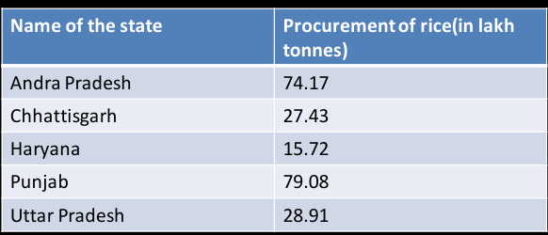
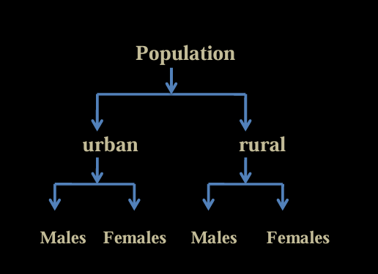
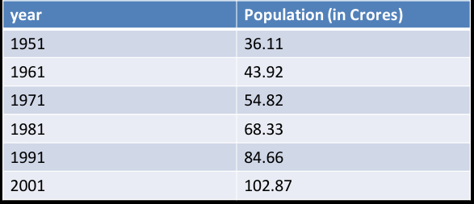
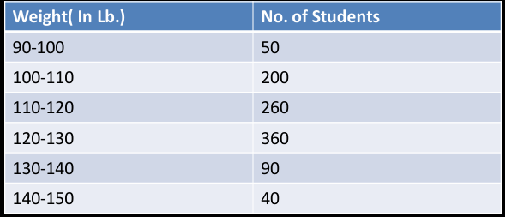
CLASSIFICATION OF DATA

Slide 11
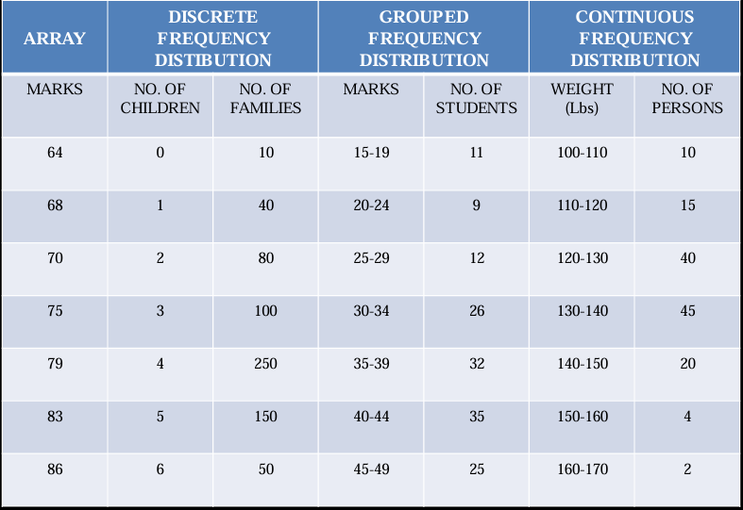
CLASSIFICATION OF DATA

